Slide 1
Data Acquisition and Data Wrangling
By: Garima Mahajan
Institute: Digicrome

Slide 2
Project Overview
Data acquisition and wrangling was performed on Dataset1,2 and 3.
The different methods employed for data wrangling were:
- Merging the datasets
- Dropping out unnecessary columns
- Checked the datatypes, summary and dimensions of the dataset, treated the missing values
Identified the outliers and checked the skewness, correlation of the data.
Box-plots were constructed for visualising the data after treating the outliers
Heatmap was constructed to visualize the correlation of the data

Slide 3
Methodology
Libraries used:
Pandas: Data manipulation library that provides data structures like DataFrames for easy handling and analysis of structured data.
NumPy: Fundamental library for numerical computing in Python, offering powerful array objects and mathematical functions for array operations.
Matplotlib: Comprehensive plotting library for creating static, interactive, and publication-quality visualizations in Python.
Seaborn: Statistical data visualization library that works well with Pandas and Matplotlib, offering high-level functions for creating informative statistical plots.
The code was executed in Google Colab notebook.

Slide 4
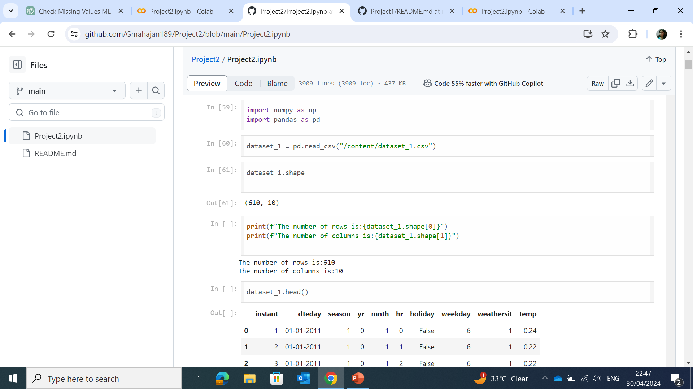
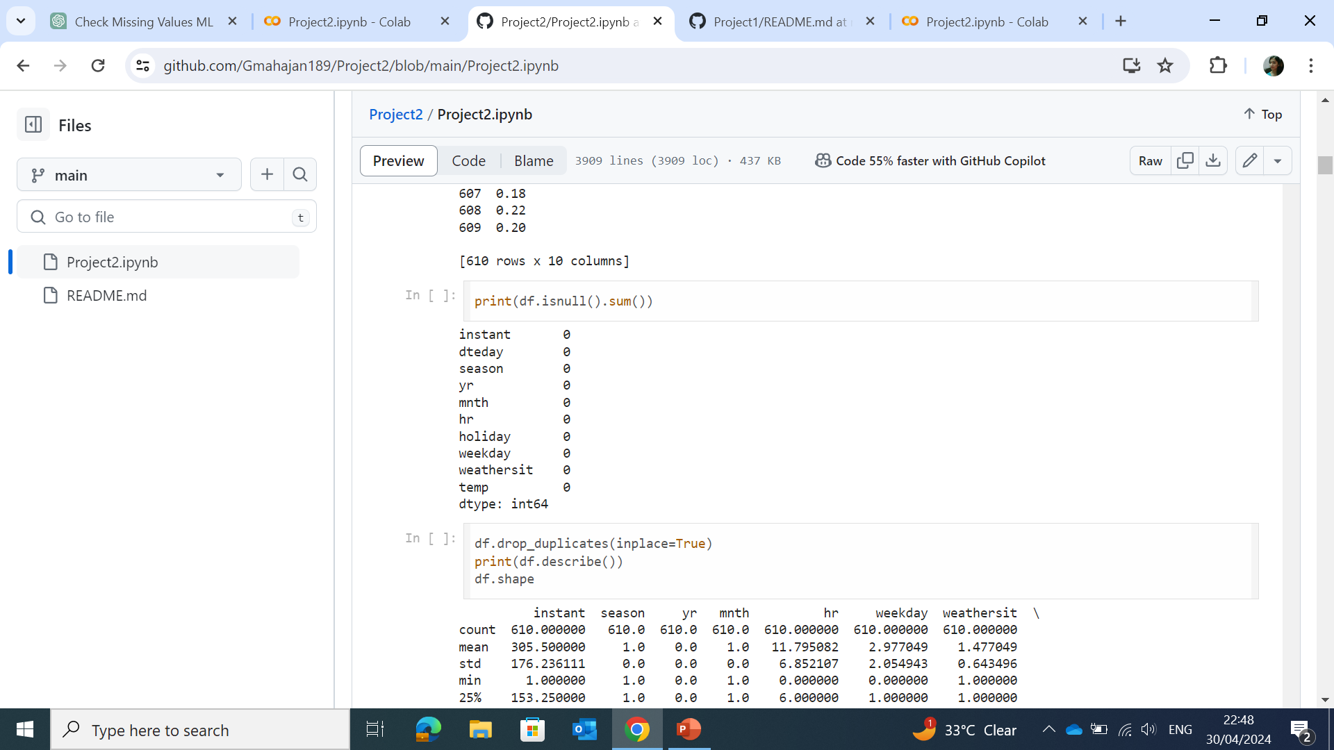
Solution
Importing the libraries
To read the csv file
To check dimension of the dataset
To check for the null values in the columns
To drop the duplicate values
To get summary of the dataset

Slide 5
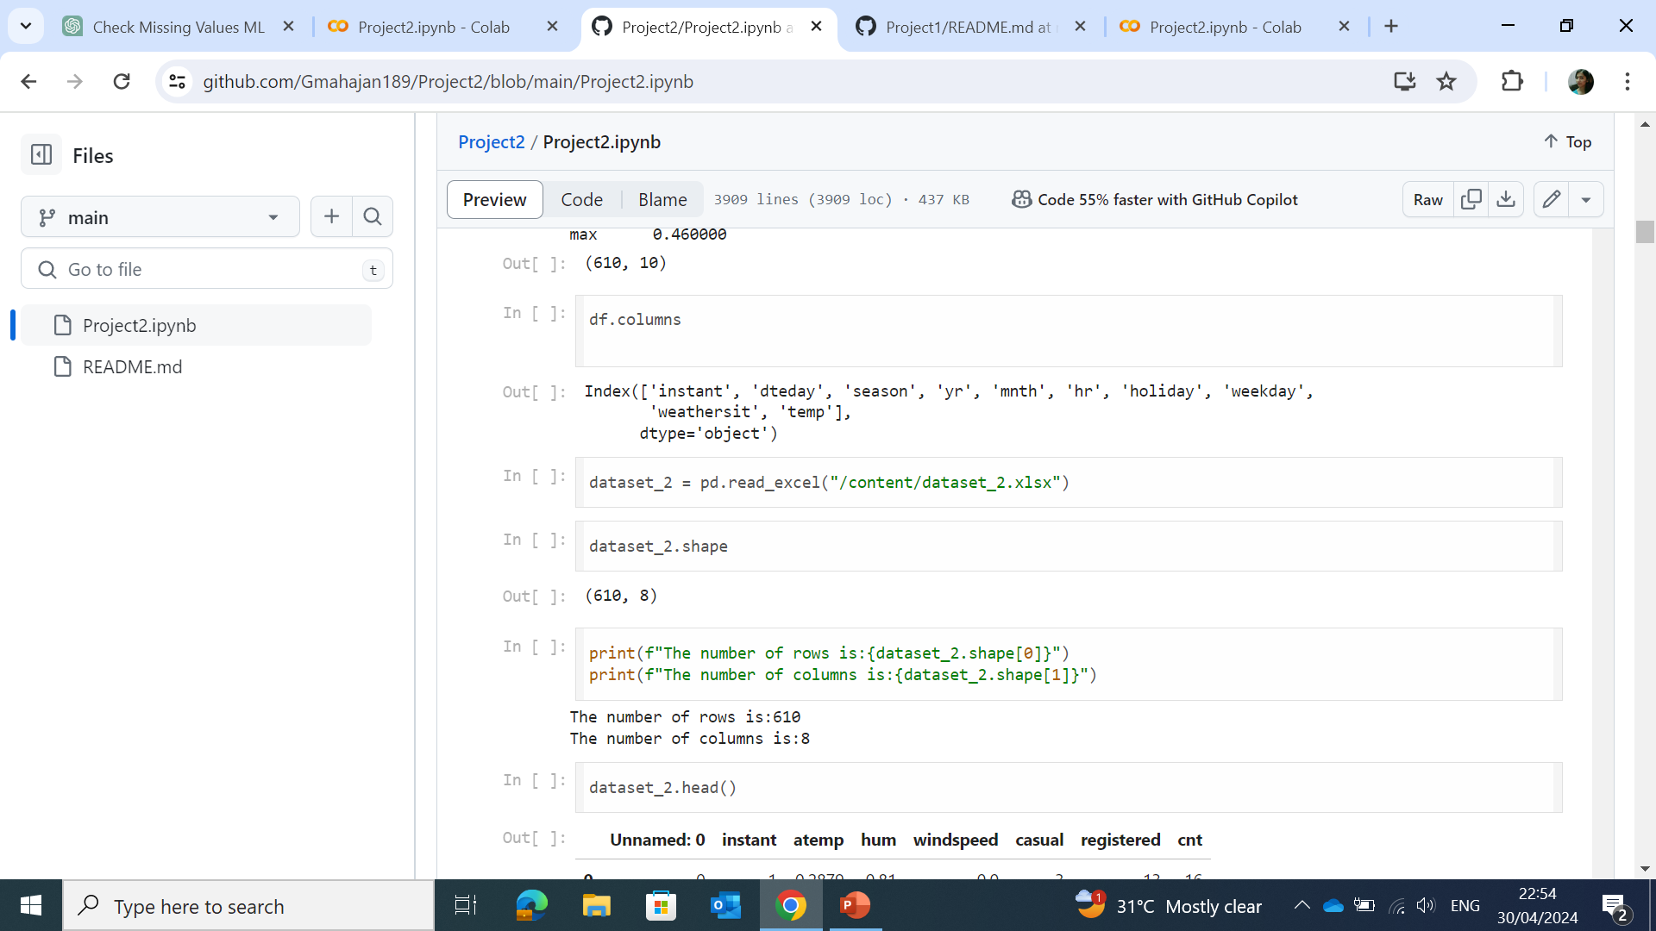
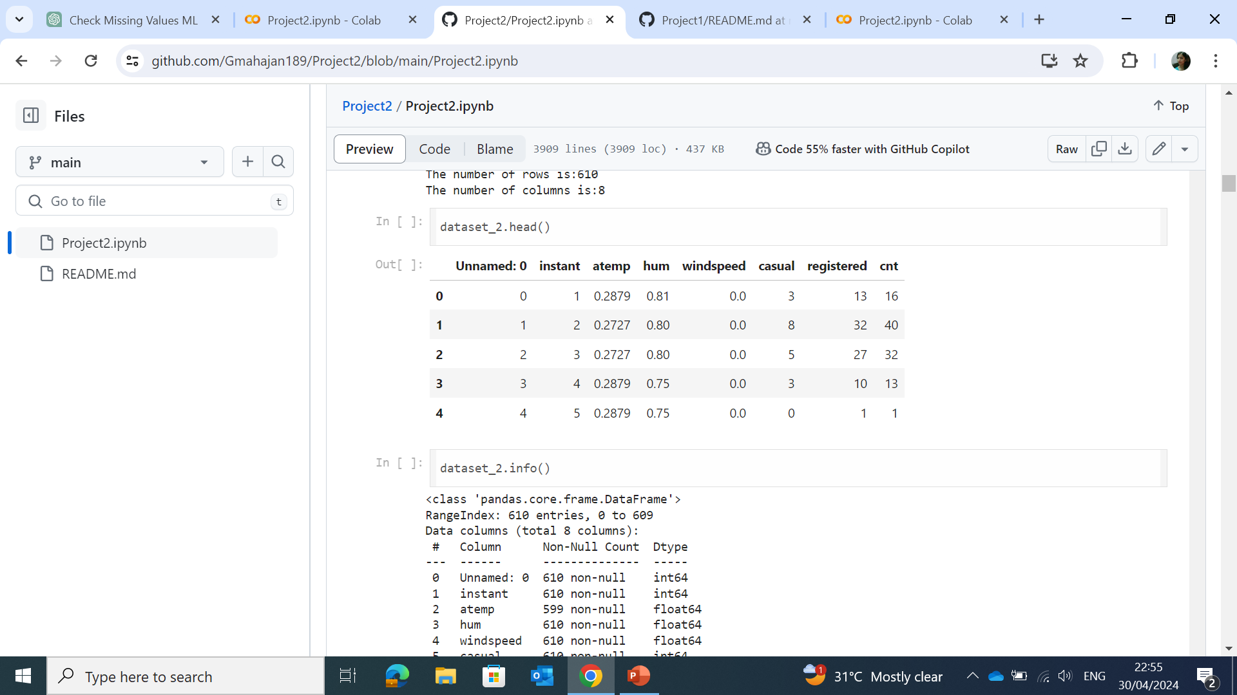
Solution
To check the columns present in the dataset
To read the excel file into pandas dataframe
To see the top 5 entries in the dataset
For the dataset information

Slide 6
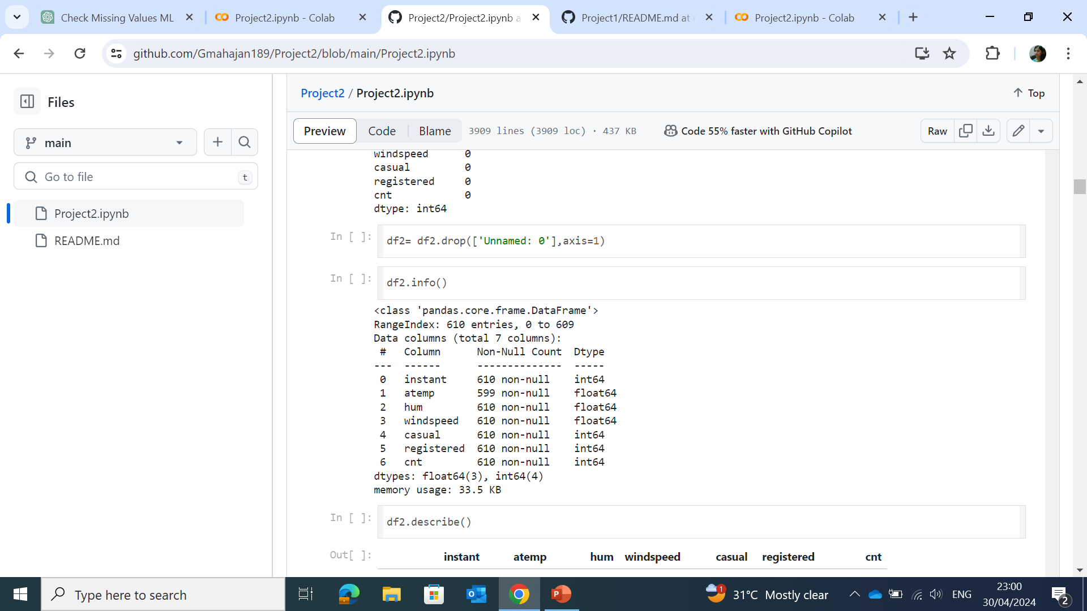
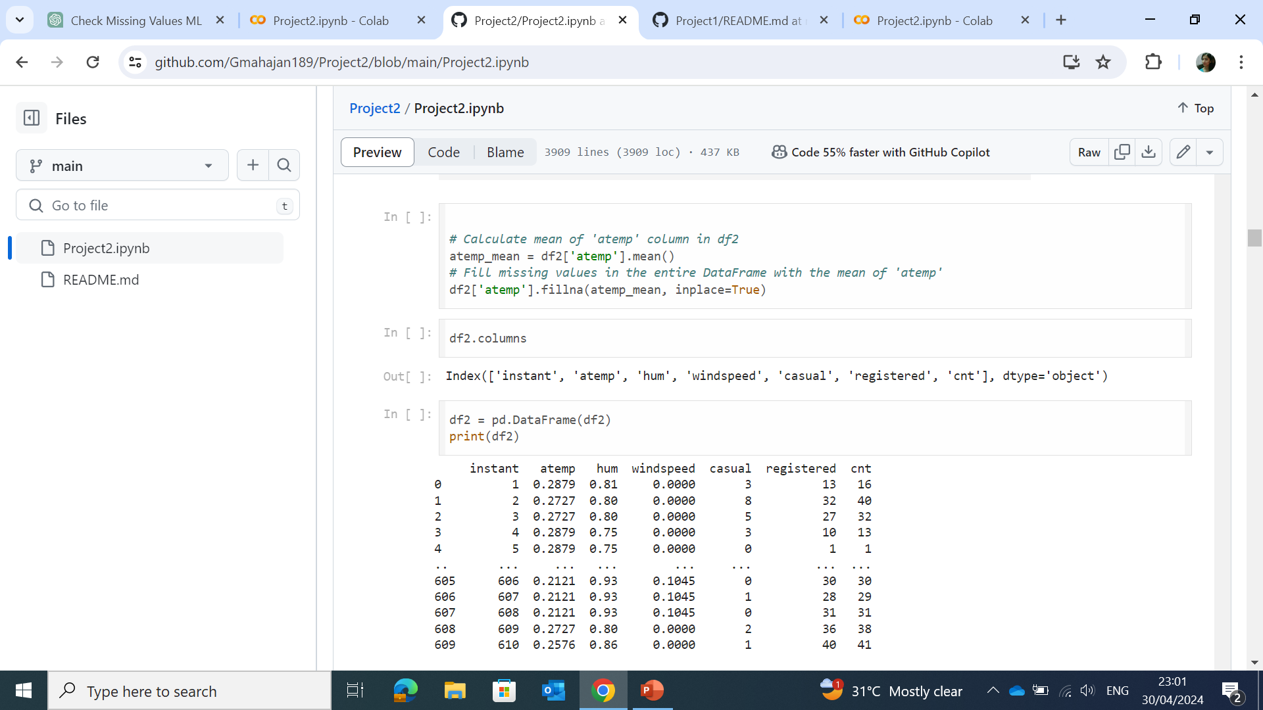
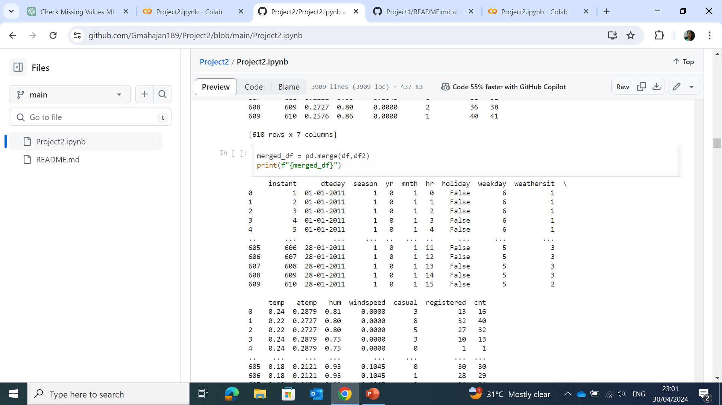
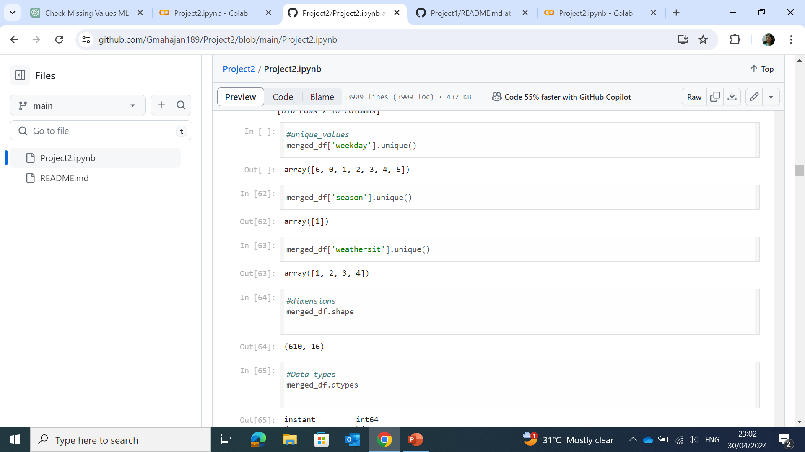
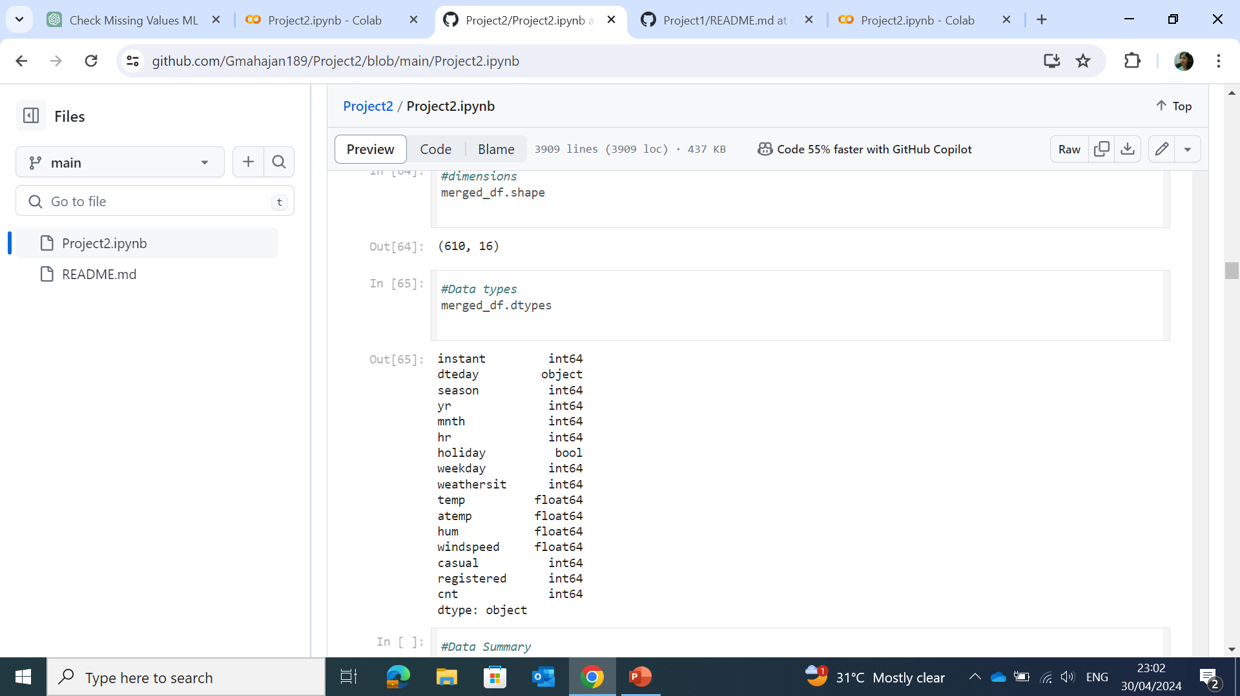
Solution
To drop the column
To replace the missing value with the mean
To merge the df and df2 dataset
To identify the unique values in the column
To check the datatypes in the dataset

Slide 7
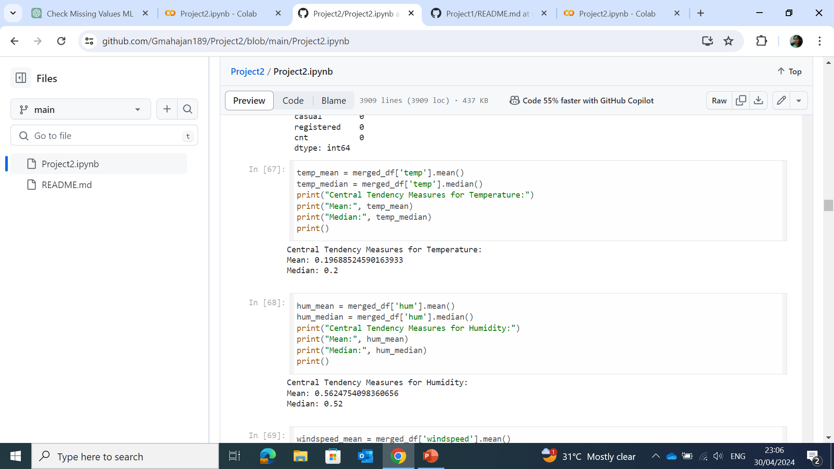
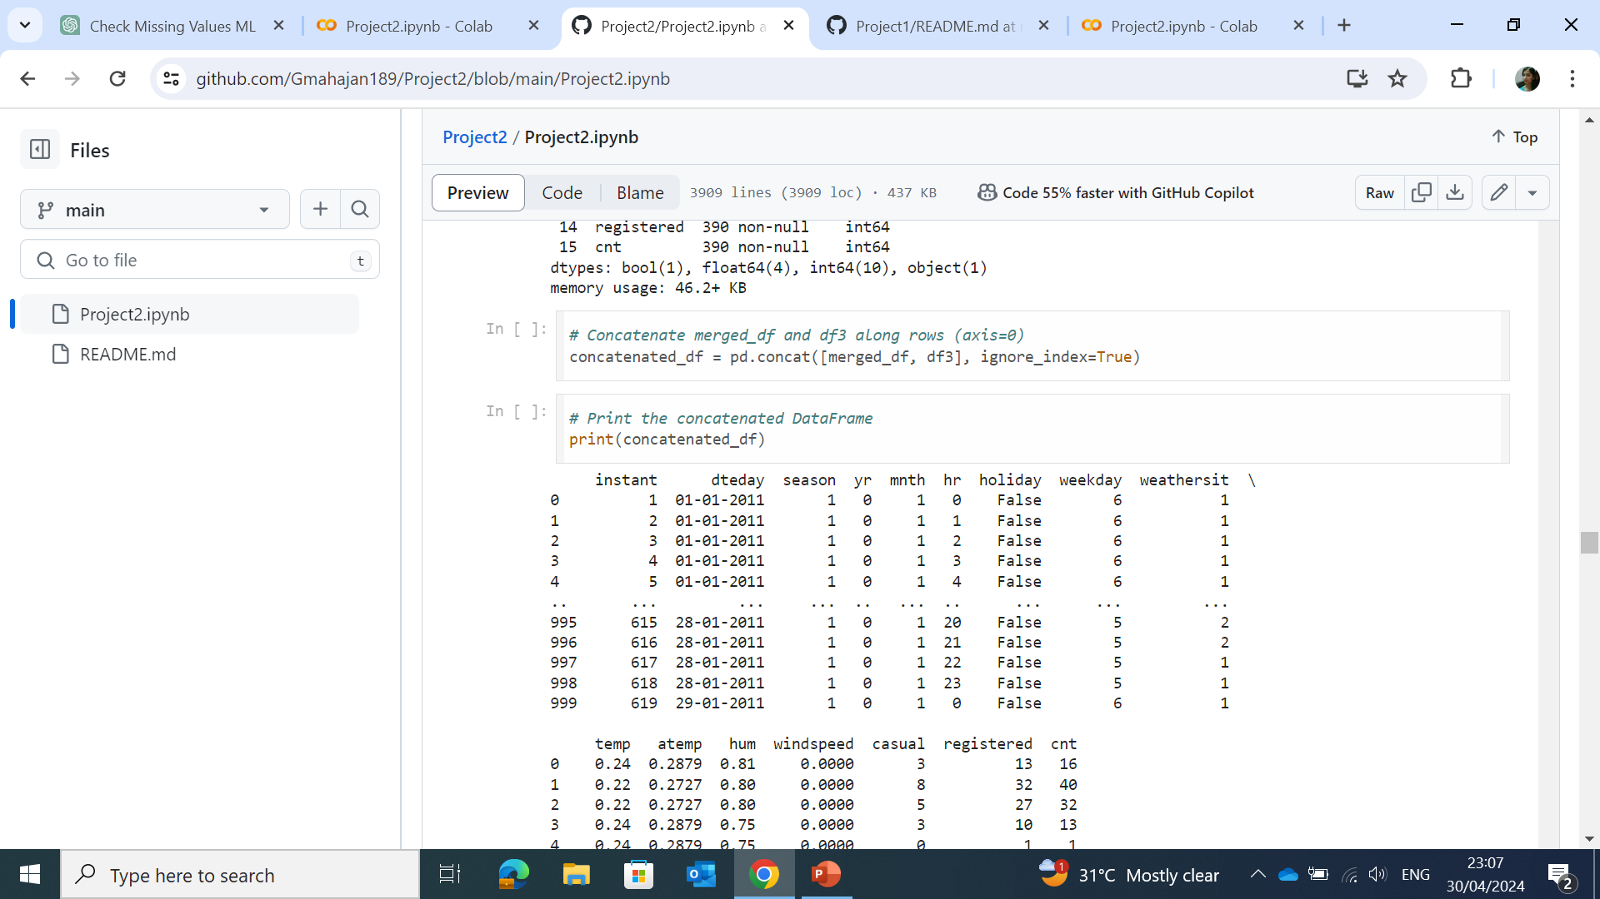
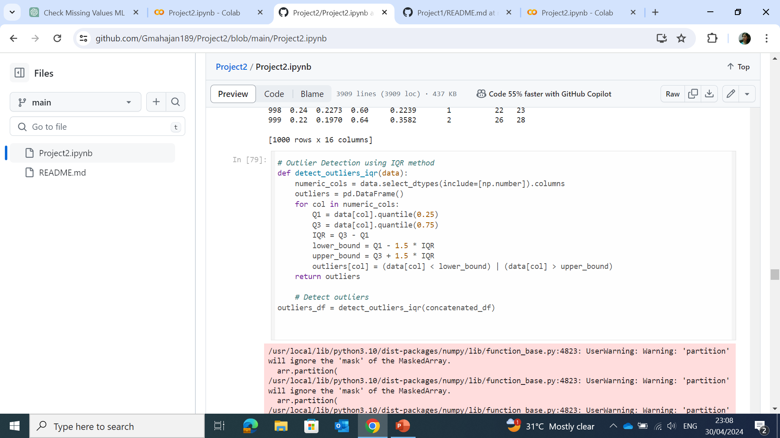
Solution
To check the central tendency of the data
Merge dataset 3 with the dataset1,2
Detect the outliers using InterQuartile Range

Slide 8

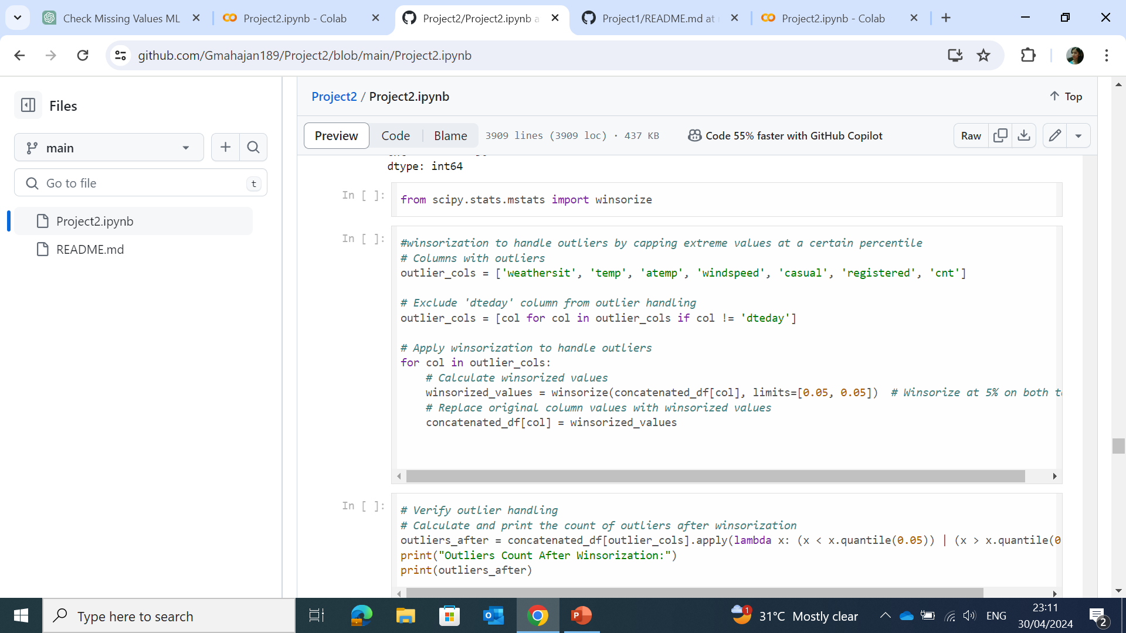
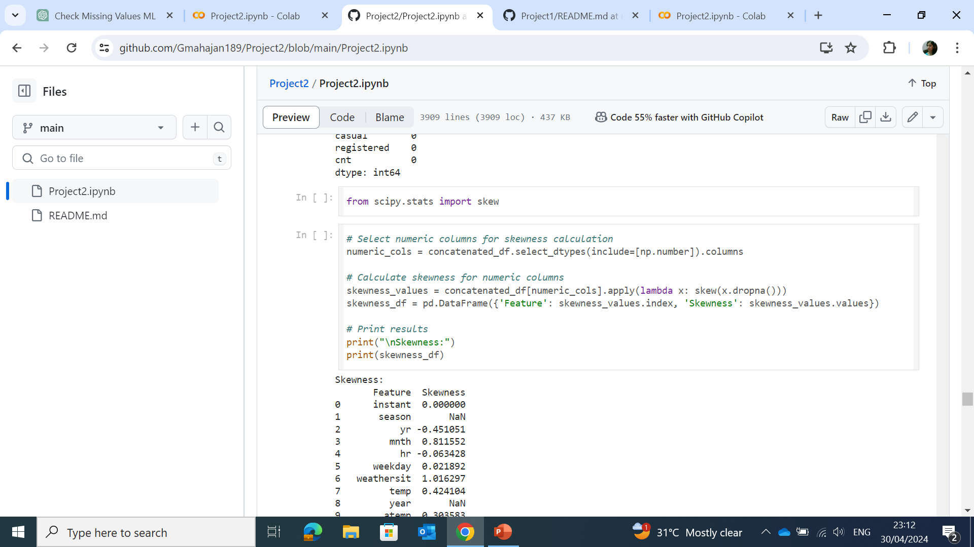
Solution
To check the count of outliers
Winsorization was used to handle outliers
Skewness of the data was checked

Slide 9
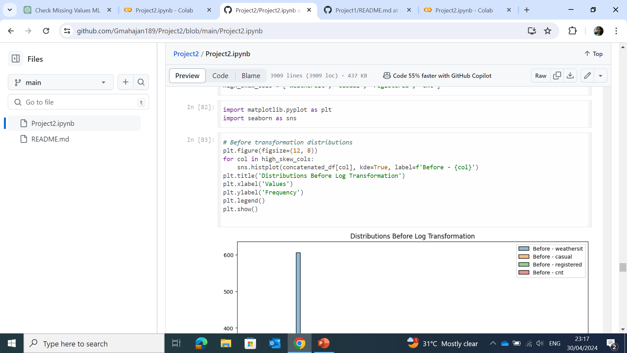
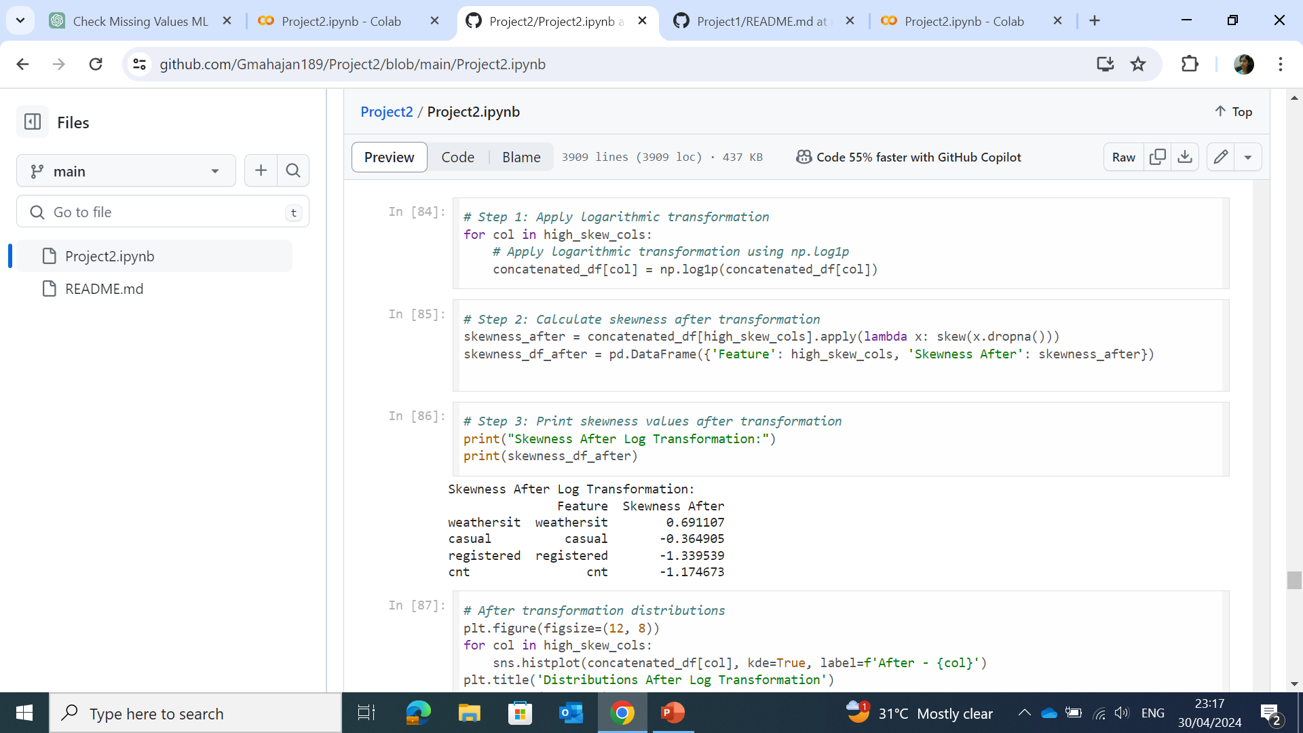
Solution
To check the distribution before transformation using histogram
The high skew columns were normalized using logarithmic transformation

Slide 10
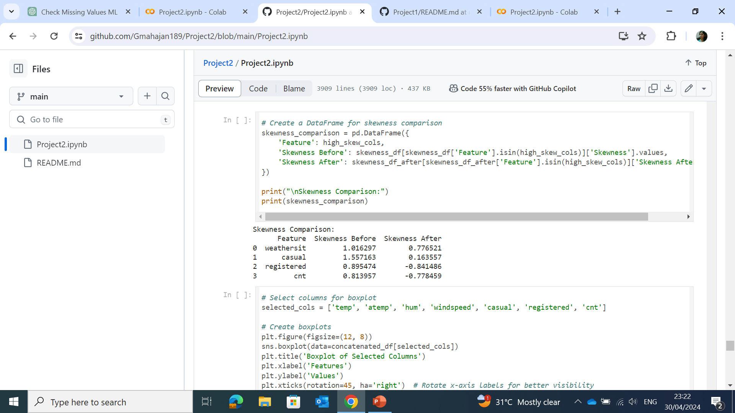
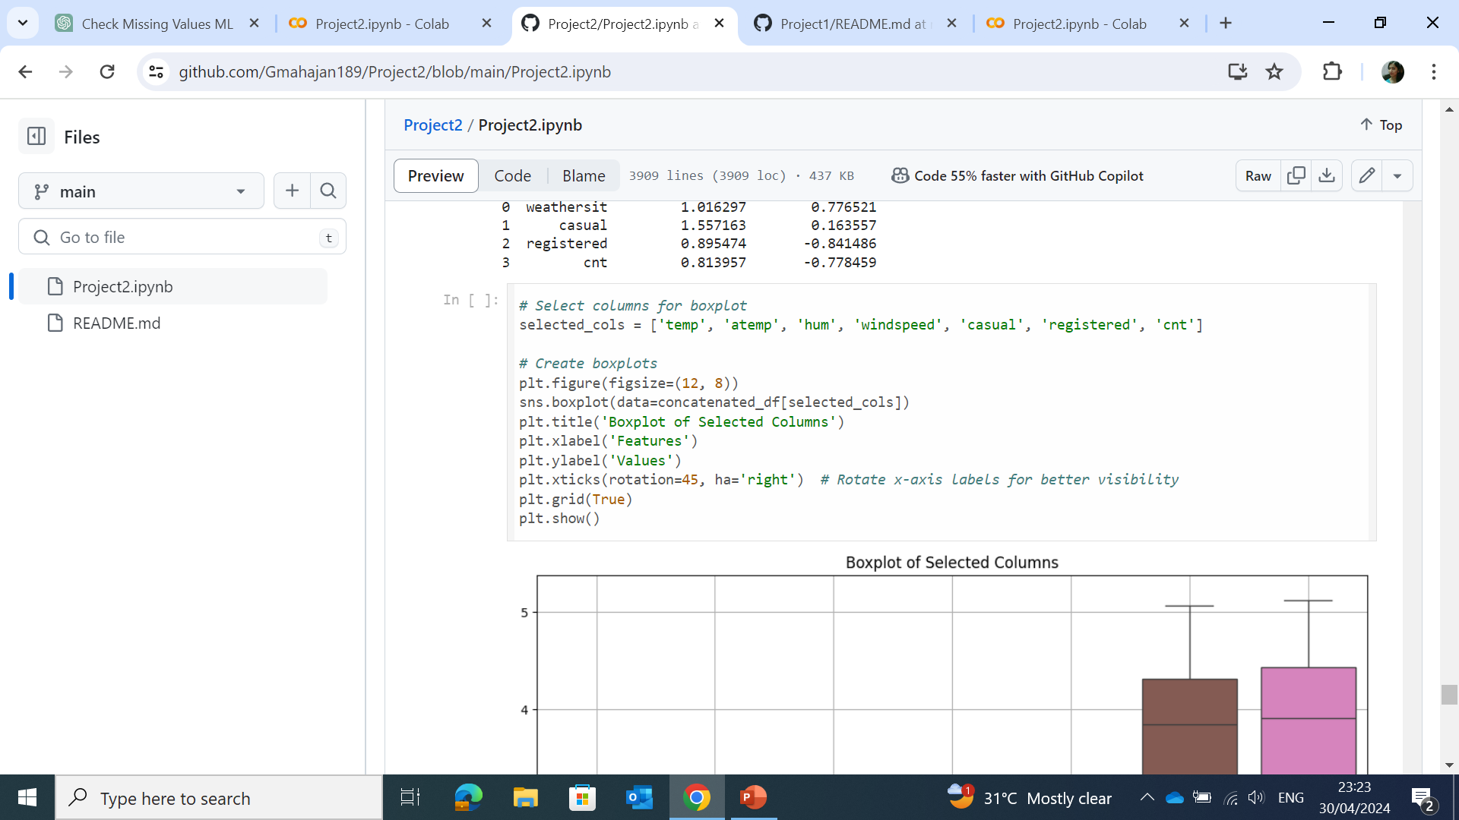
Solution
Before and after logarithmic transformation skewness was compared
To construct the box-plot for the selected columns

Slide 11
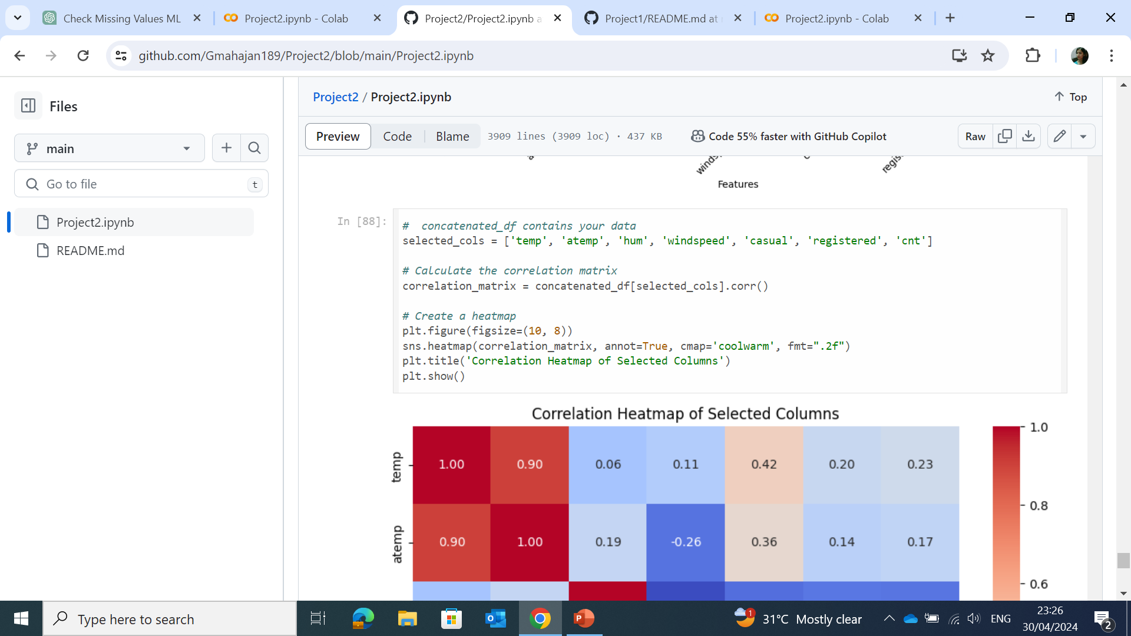
Solution
To calculate the correlation matrix for the selected columns and create heatmap to visualize the correlation

Slide 12
THANK YOU!

